Slide 1
Heart for Art
Virtual Sessions

Slide 2
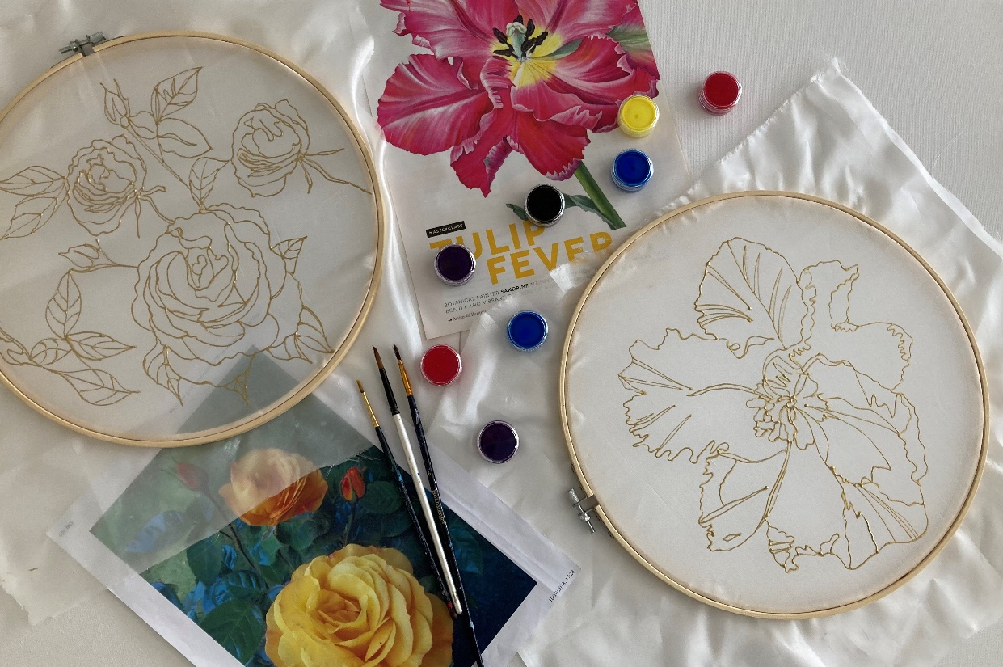
Art Packs

Slide 3
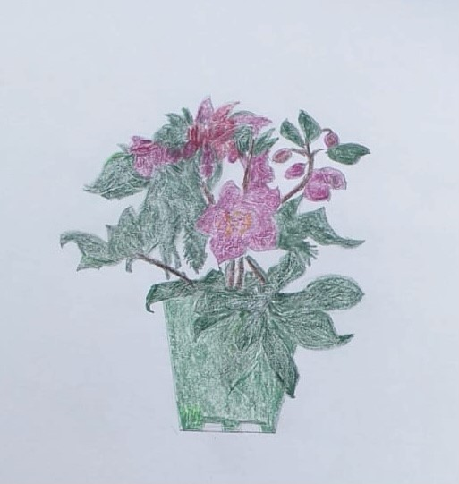
Colin McDowall

Slide 4
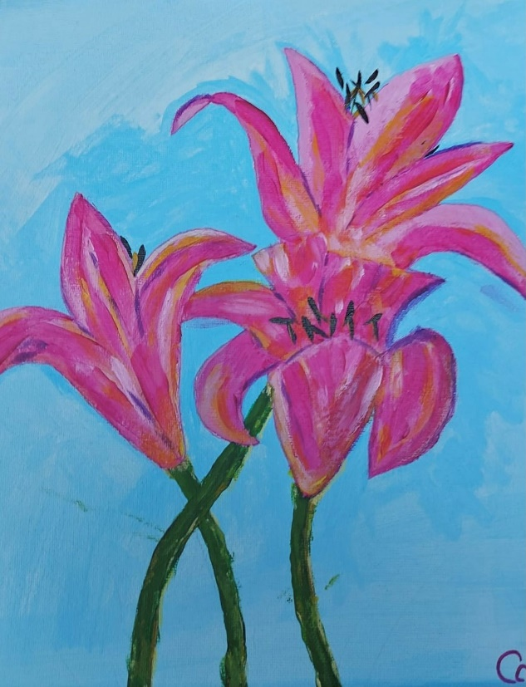
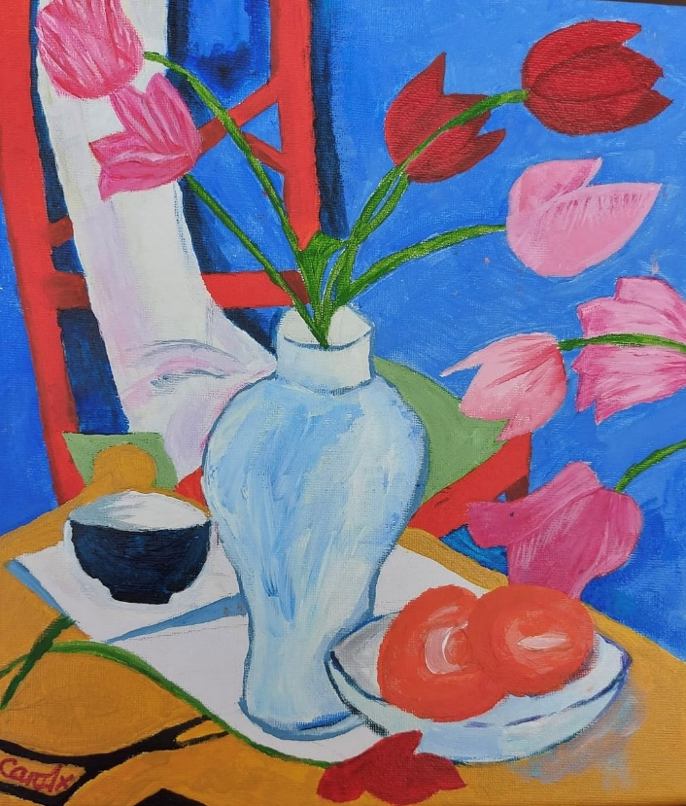
Carol Topper

Slide 5
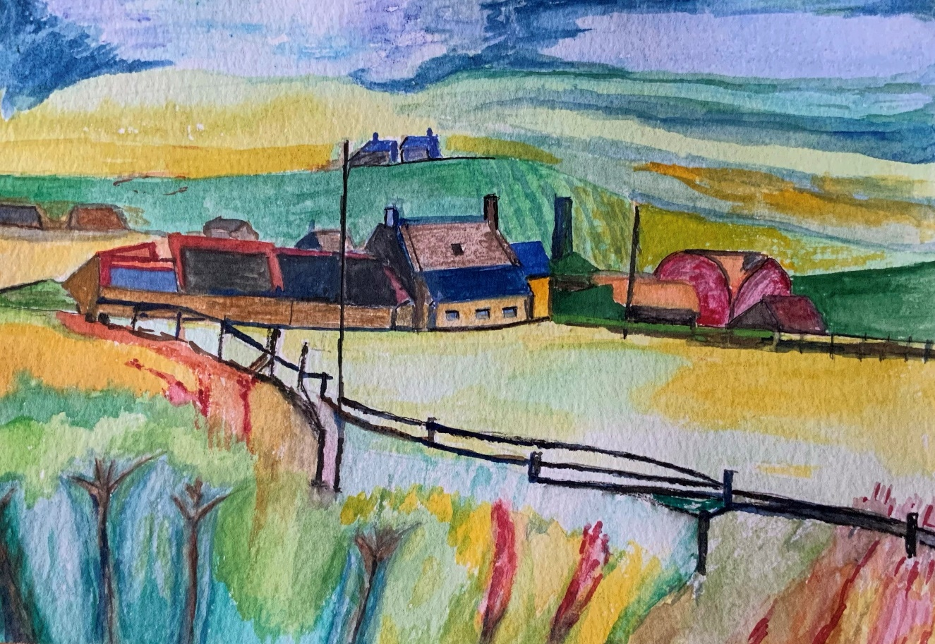
Fred Singleton

Slide 6
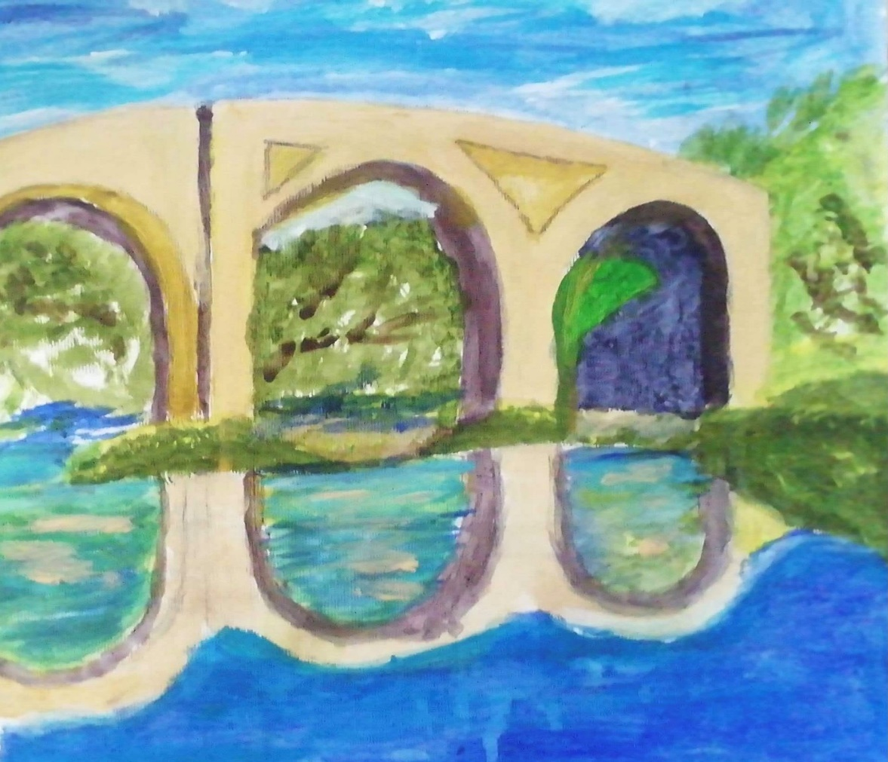
Stephen O’Brien

